Slide 1
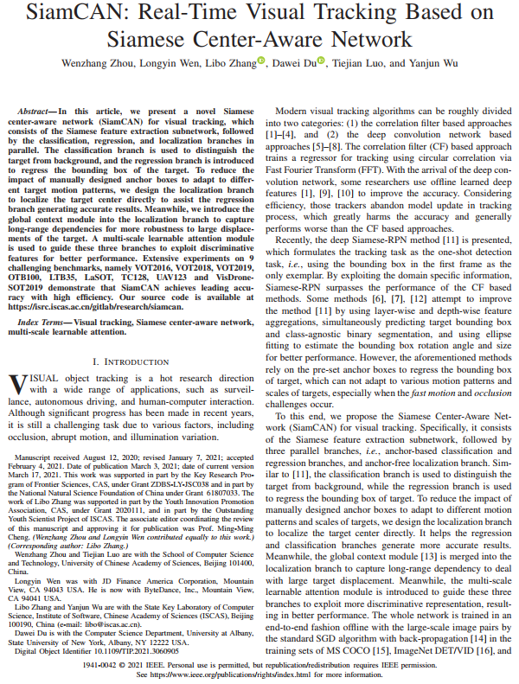
Seminar presentation (25th March 2021)
SiamCAN: Real-Time Visual Tracking Based on Siamese Center-Aware Network
Published in IEEE Transactions on Image Processing
(IEEE TIP-2021)
Presented by:
Md. Maklachur Rahman School of Computer Science and Engineering
Kyungpook National University
Republic of Korea

Slide 2
Main contributions
They propose a visual tracker named SiamCAN, where the classification, regression, and localization branches are jointly trained using multi-scale learnable attention module.
They enhance the localization branch using global context to obtain more robustness for large target displacement.
They utilize anchor free and anchor box method together for improving the tracker performance.

Slide 3
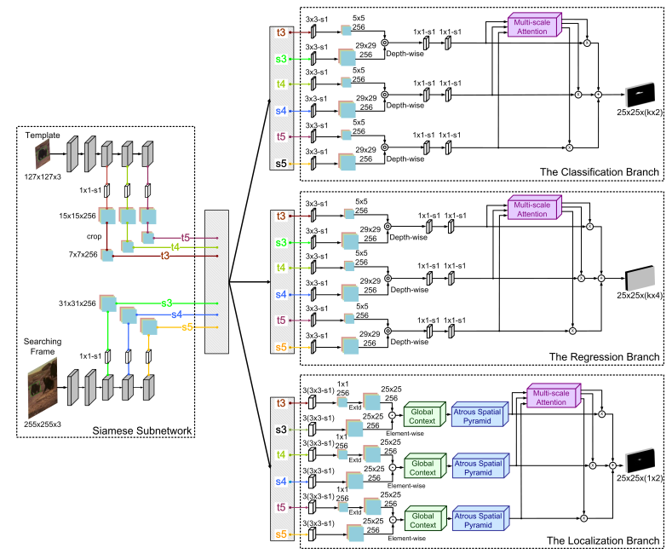
Tracker framework
Fig. 1. The architecture of our SiamCAN method, which consists of the Siamese feature extraction subnetwork followed by the classification, regression, and localization branches in parallel. The pairs of feature maps from different layers of the Siamese feature extraction subnetwork are fed into the three branches. “3 × 3-s1-d2” denotes a convolution layer with 3 × 3 kernel, stride 1 and dilation rate 2.

Slide 4
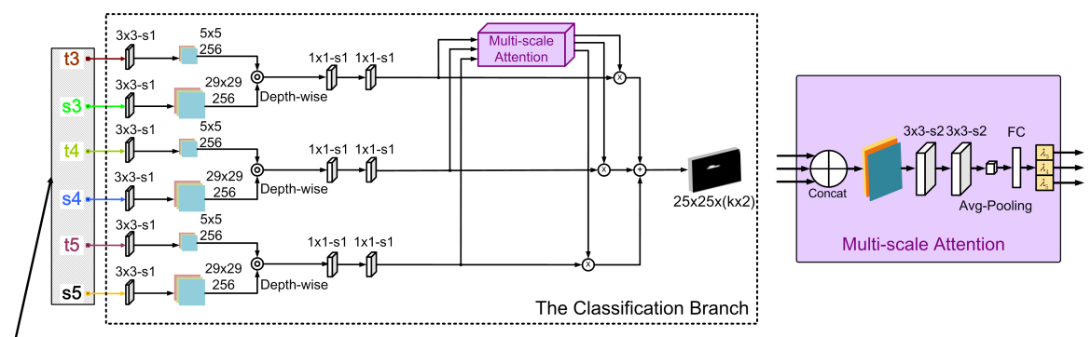

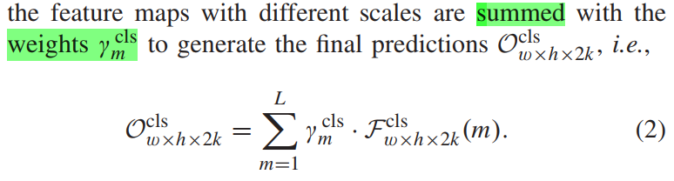
Tracker framework [continue]
The classification score is calculated is by the following equations:

Slide 5
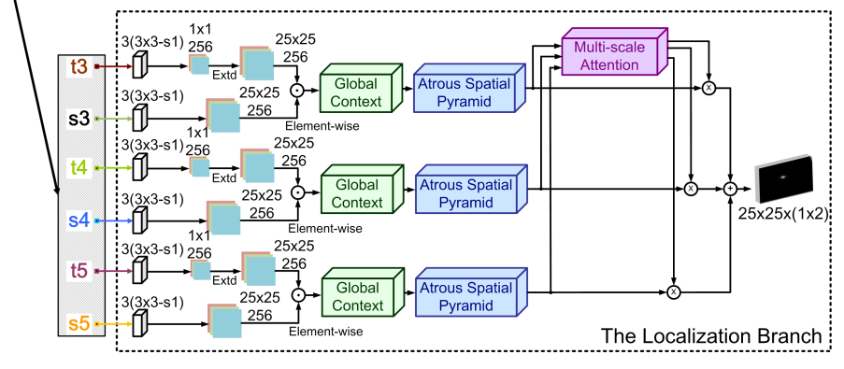
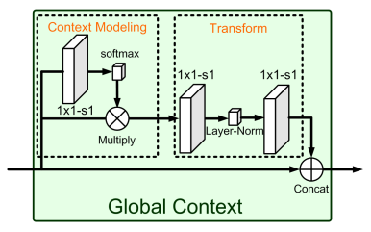
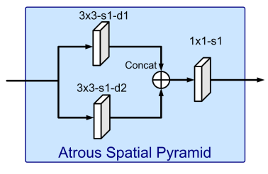
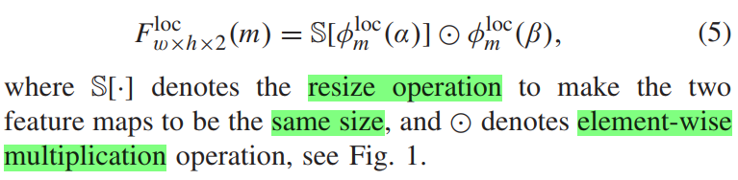
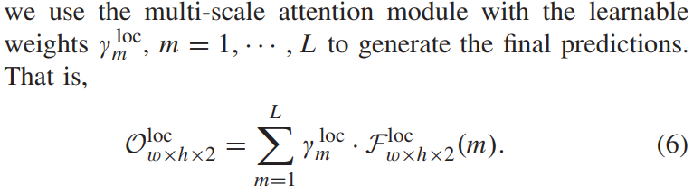
Tracker framework [continue]

Slide 6
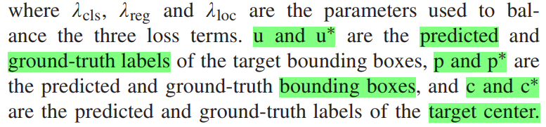
Loss function
The overall loss function is computed as:
They use the cross-entropy loss to supervise the classification and localization branches, and L1 loss to supervise for the regression branch.

Slide 7
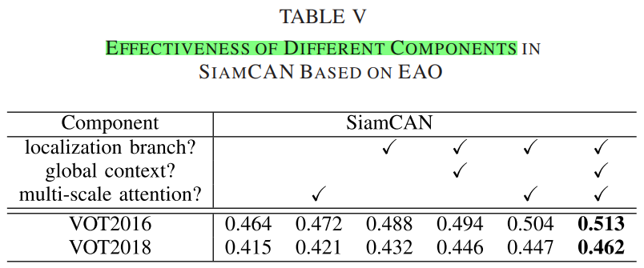
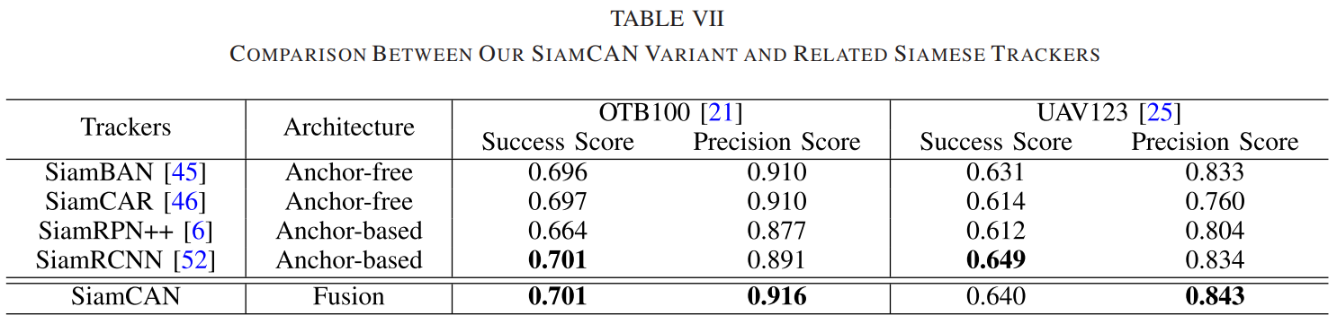
Ablation study on several benchmarks

Slide 8
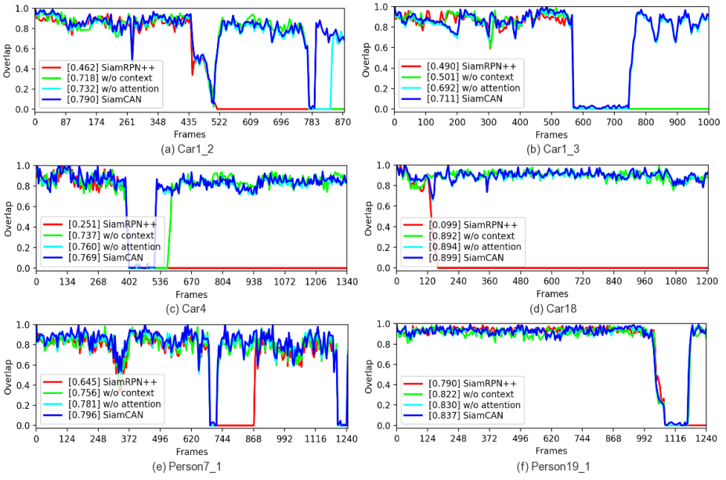
Ablation study on frame no vs overlap score
Fig. 9. Tracking results of six videos for different SiamCAN variants.

Slide 9
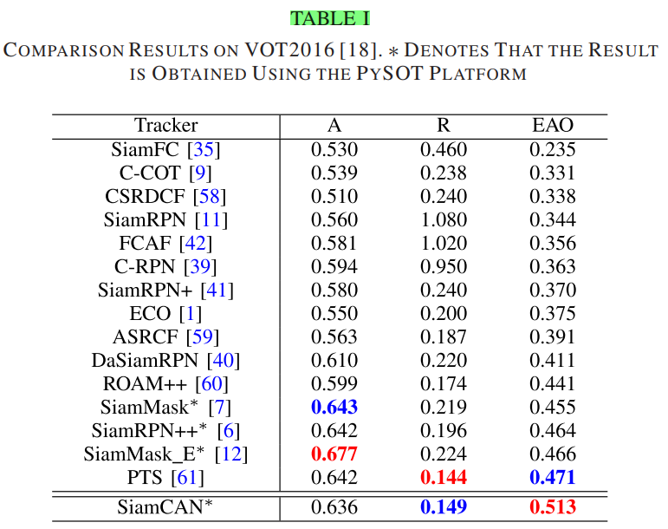
Comparison results on VOT2016 benchmark

Slide 10
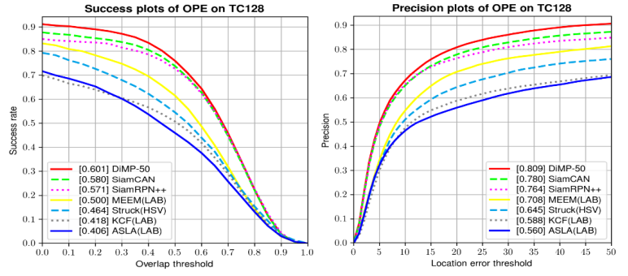
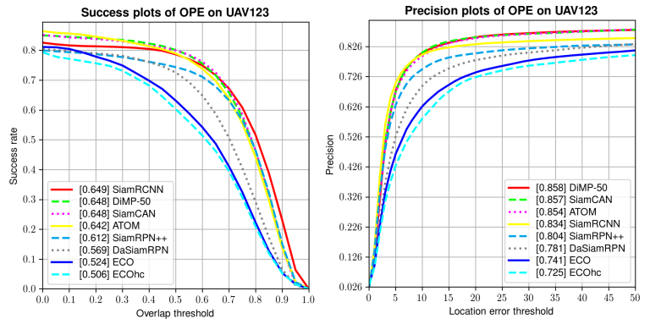
Comparison results on TC128 and UVA benchmarks
Fig. 5 and 6. Success and precision plots on the TC-128 and UAV123 benchmarks.

Slide 11
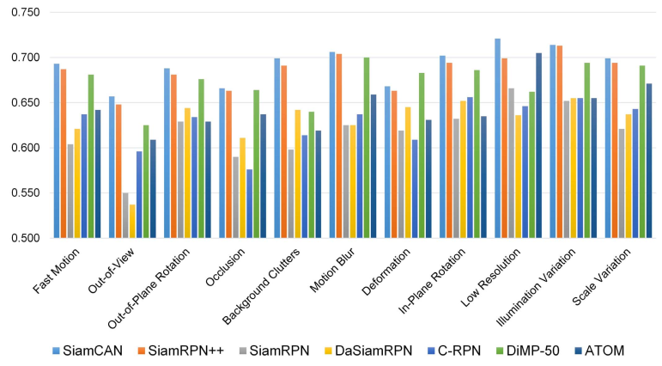
Comparison on several challenging attributes
Fig. 8. Success score of the proposed method in each challenging attribute on OTB100.

Slide 12
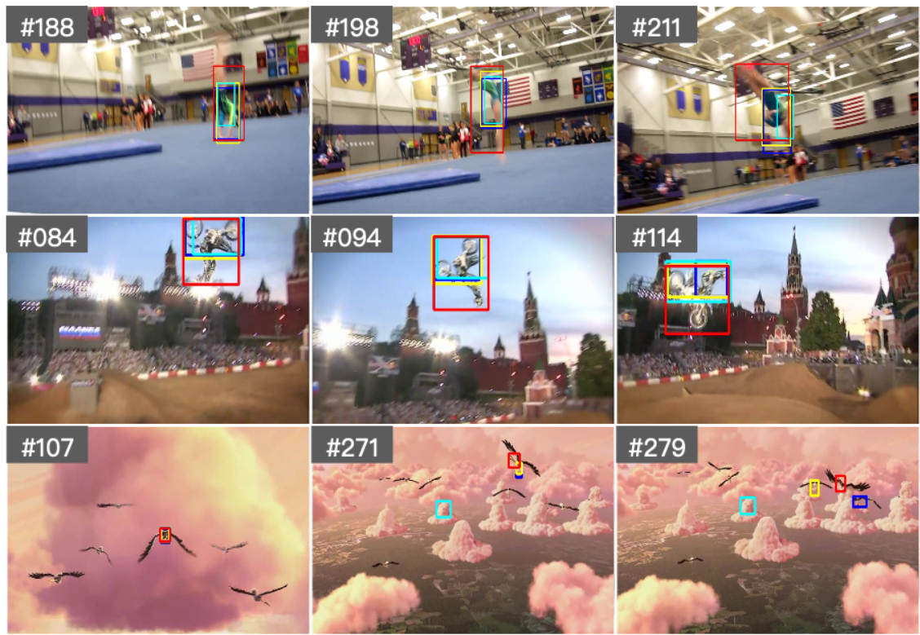
Qualitative comparison
Fig. 2. Visual results of our approach compared with state-of-the-art trackers. The first and second rows denote the VOT2018 dataset. The third row denotes the OTB100 dataset.

Slide 13
Conclusion
They perform extensive experiments on several benchmarks and achieve state-of-the-art performance.
The fused anchor free and anchor box based methods provide better performance.
Their proposed Siamese center-aware network runs at 45 fps.

Slide 14
ধন্যবাদ 감사합니다 Thank you Q&A

